Slide 1
Crime Rate Predictive Analysis
Group Members
Pushpendra Sharma
Rachna Kumari
Don Sohn
Suzanne Douglas Herby Robinson

Slide 2
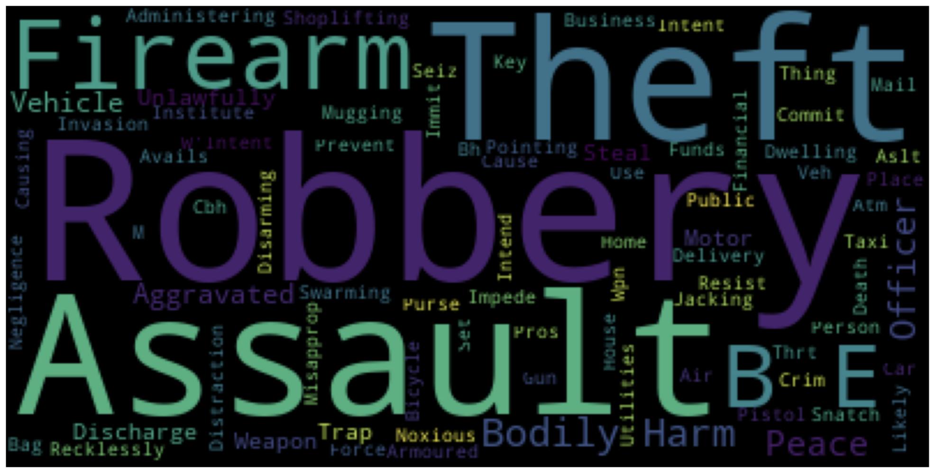

Slide 3
Introduction:
Towards the latter part of the twentieth century theories explaining the causation of crime shifted away from biological and
psychological factors towards more social and environmental explanations. This shift allowed for the factors to be quantified and abstractly analyzed in an attempt to do better policing by being proactive instead of reactive.
The modern era of “big data” has presented both new opportunities and new challenges for policing as it has allowed for the harnessing of computing power to fight crime. As the volume, variety and available data increases, computer modelling has become an invaluable tool to assist in proactive policing by using predictive modelling in the allocation of resources.
In this project we will creating models based on existing crime data covering the period 2014 - 2019 coupled with demographic data to predict crime. Its goal is to establish a relationship between certain data elements and the crime rate. Once these relationships are established it is the hope that targeted policing and resource allocation can be done using these models to reduce crime. It must be noted however that while a correlation may exist that does not necessarily imply causation.

Slide 4
Business Question:
To create a model that accurately predicts crime while investigating the possible correlation between the prediction, demographics and social services.
The purpose for our model is to assist in crime reduction via effective resource reallocation.
Notes:
To summarize our introduction our business question is To create a model that accurately predicts crime while investigating the possible correlation between the prediction, demographics and social services. It is our belief that this model will not only allow for highly effective proactive policing but also resource allocation across multiple levels of government thereby reducing crime.

Slide 5
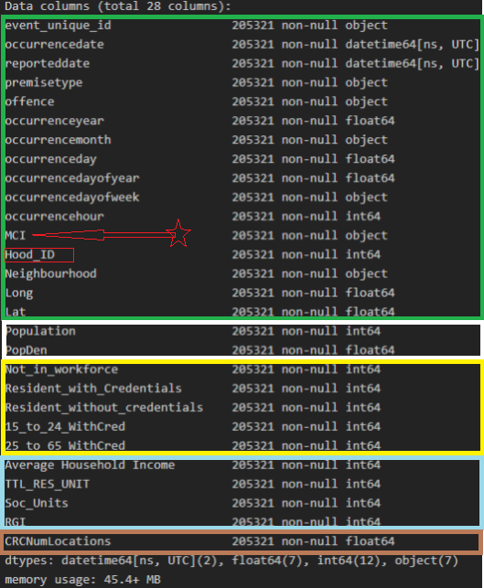
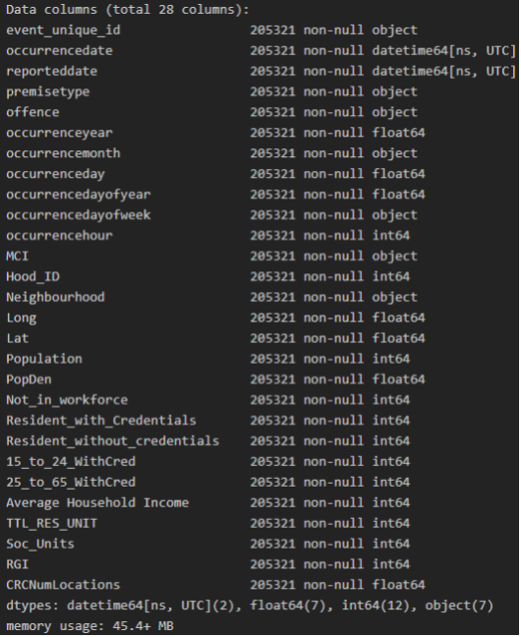
Variables
Input Variables:
Population Density
Average Household Income
Education
Rent geared towards income
Toronto recreation centres
Output Variables:
TPS Data: 2014-2019 crime by MCI
Assault, Auto Theft, Break and Enter, Robbery,
Theft Over
Notes:
The Diagram depicts our master dataset used for modelling . It highlights that our input variables were derived from 5 other datasets (subsetted by the colored squares) with Hood_ID being the common denominator between all the sets. MCI was our target variable which indicated the crime committed and this resided In the TPS dataset.

Slide 6
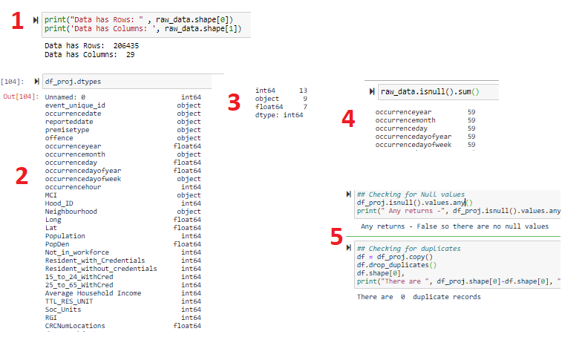
Data Exploration
Notes:
In this phase of the project we did basic analysis of the data to not only spot any anomalies in the data that could negatively impact other areas but also anything that would pique our interest for further exploration. As shown in Fig 1 after loading the dataset we were able to conclude that we were working with 206435 records each containing 29 fields.
Our data type analysis resulted in Fig 2 and the summary information of step 3 which highlighted that of the 29 fields 9 were of type object ie strings, 12 were integers and 7 were floats. A basic null data analysis let to figure 4 in which we recognized that there were 59 records that had null values in five fields related to date. On closer observation we realized that these date of the event related to these values fell outside of the 2014-2019 timeframe that we were considering and as such they should be deleted from the dataset. After cleaning the data The resulting Figure 5 shows that the dataset had .205321 records with no nulls and no duplicates

Slide 7
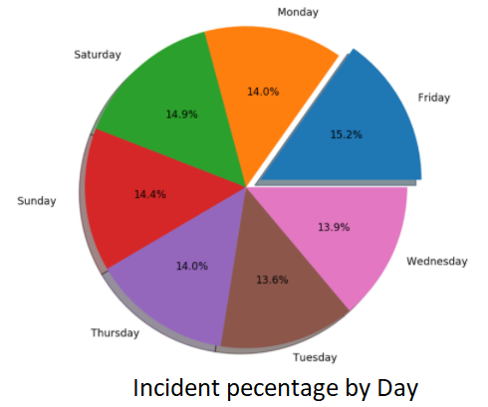
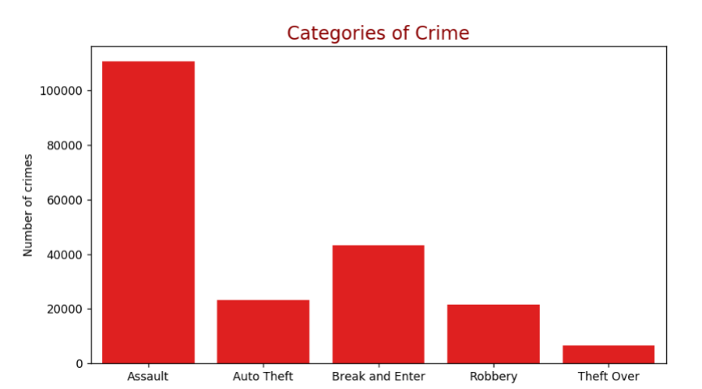
Data Exploration
Notes:
When we moved on to actually doing introductory data analysis for modelling and the data yielded that assault was the most prevalent MCI category and that it surpassed the other categories by a sufficient extent that it had the possibility of skewing our model. Also, we noticed that the most incidents were reported as occurring on a Friday.

Slide 8
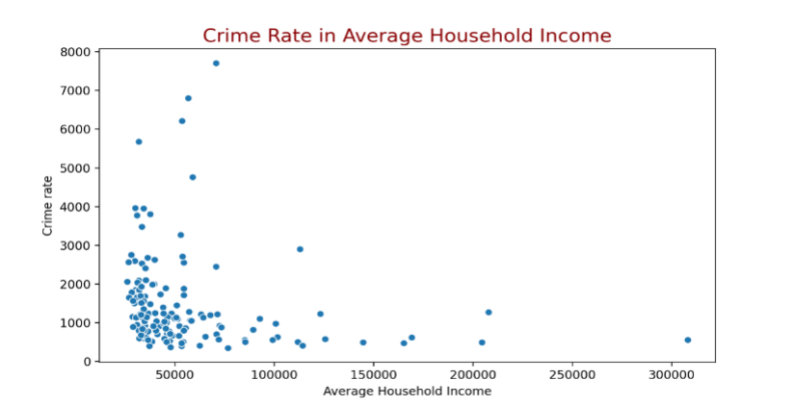
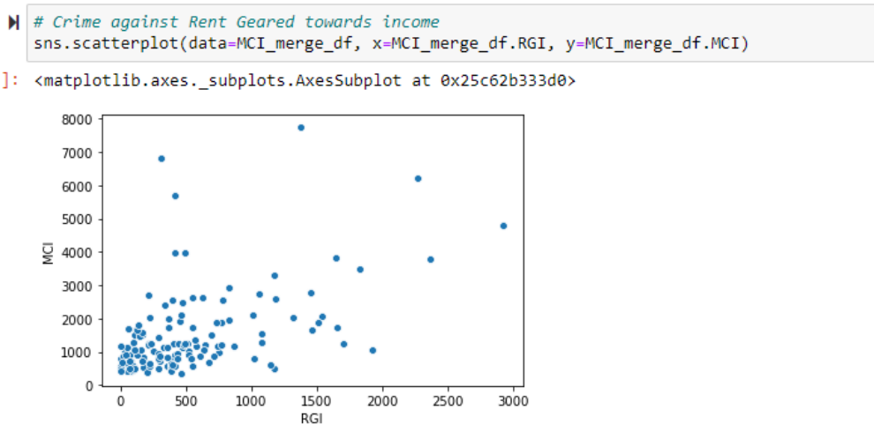
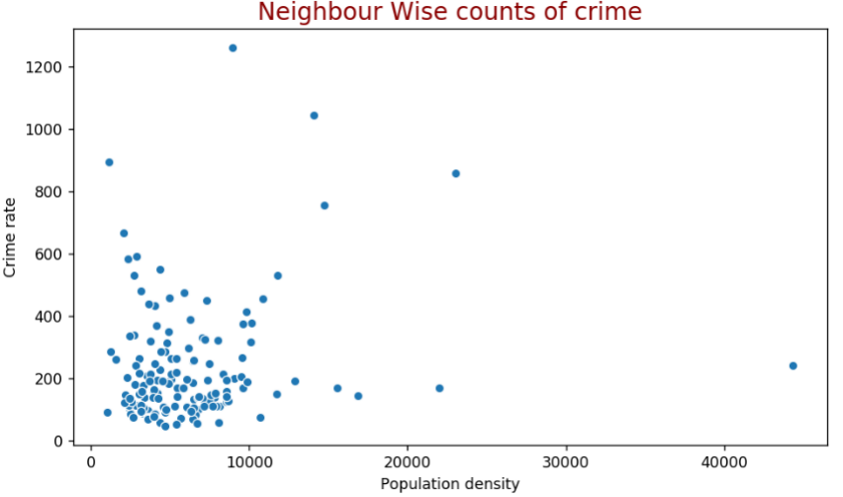
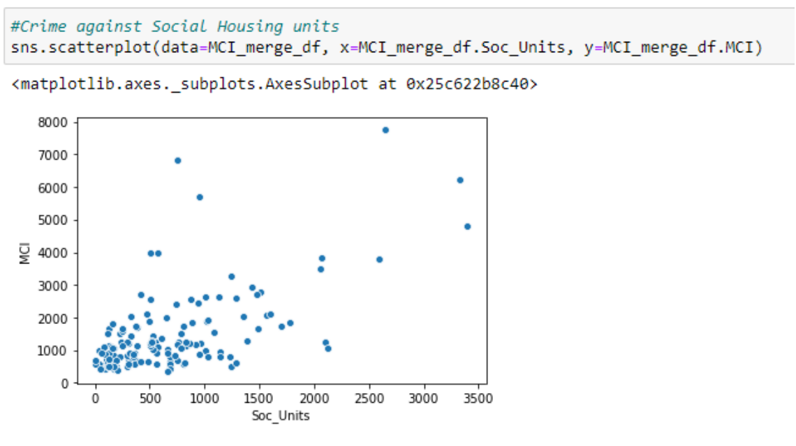
Data Exploration
Notes:
When analyzing the merged dataset and focusing on demographic information in some cases existing perceptions were substantiated but in other cases we were somewhat surprised.. 1) When plotting Social Housing Units vs Crime based on common perception or misconception we would have expect to see the crime rate highest for the highest social unit count but while the relationship seems somewhat linear that was not the case.The data did however indicate that there was possible and need for more social housing units and that there is a lose connection between social housing units and crime. The same ‘loose connection’ analysis can be derived from our plots of crime verses Average Income, rent geared towards income (RGI) and population density but all indicate that there may be underlying factors.

Slide 9

Unsupervised Learning
Notes:
2 questions
Social services
Discovery
ArcGIS
Loaded TPS layer
Plot individual crimes from dataset 2014-2019 (200K records)
Centroids for rec centers
Blue : centroids of crime in neighbourhoods with 2 or less rec centers
Green :centroids of crimes in neighbourhoods with 3 or more rec centers

Slide 10
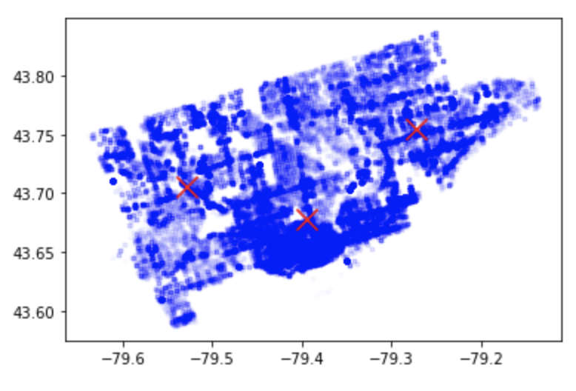
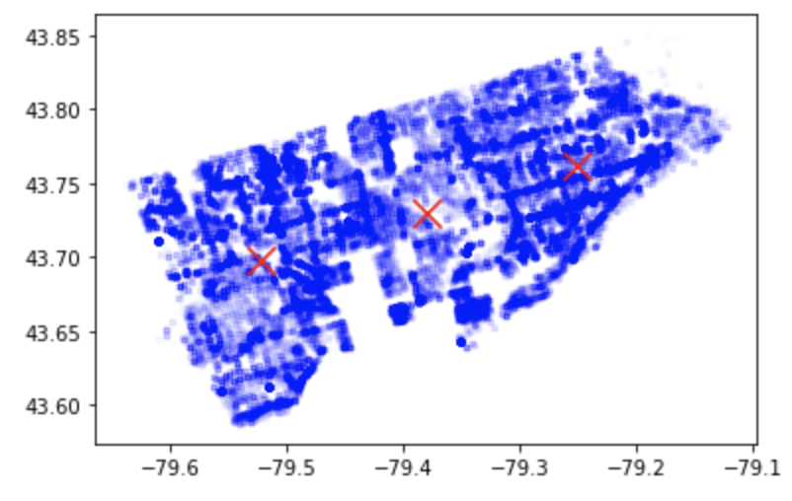
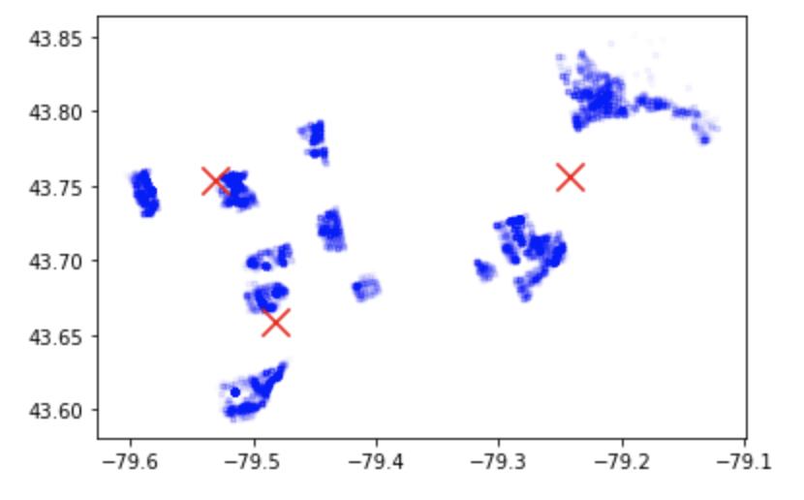
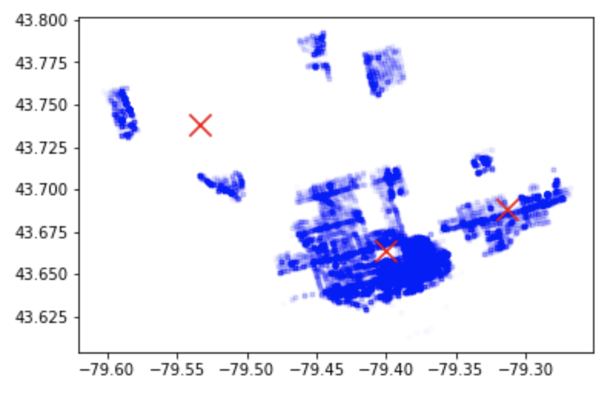
Unsupervised Learning
Neighbourhoods with 2 or less rec centers
Population density less than the mean
Does a neighbourhood’s
social services and
demographics matter?
Neighbourhoods with 3 or more rec centers
Population density greater than the mean
Notes:
Could be more centroids but generally indicates there is clear clustering for those with rec center < or > 2

Slide 11
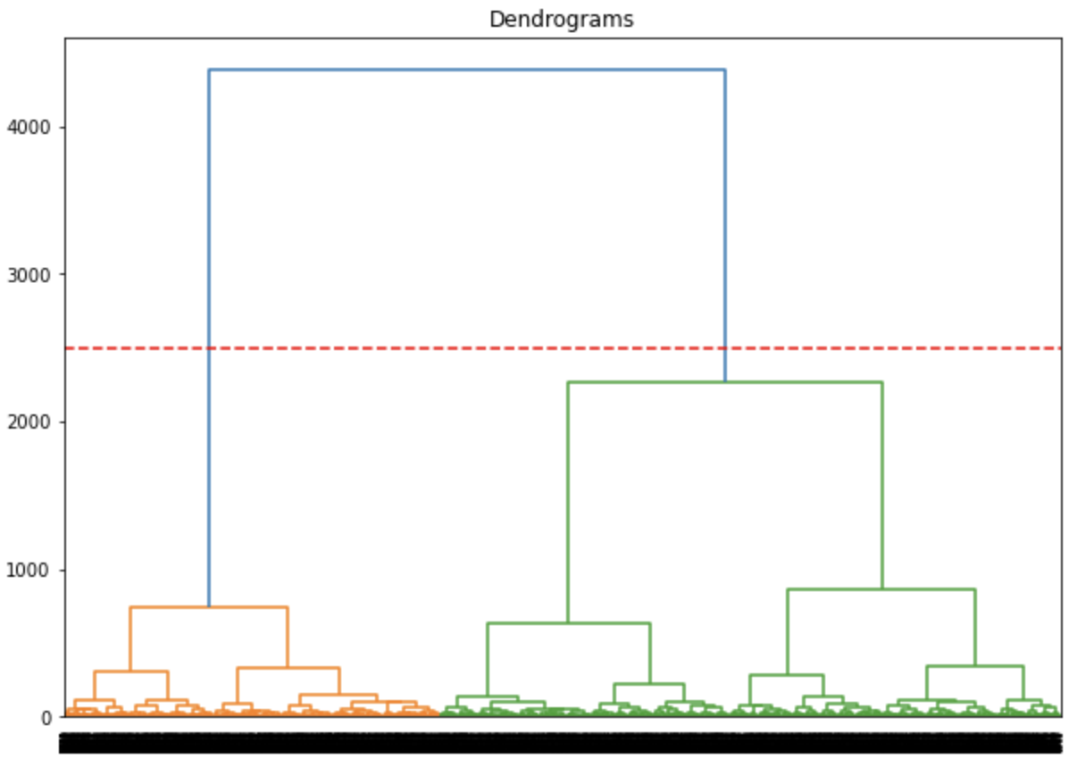
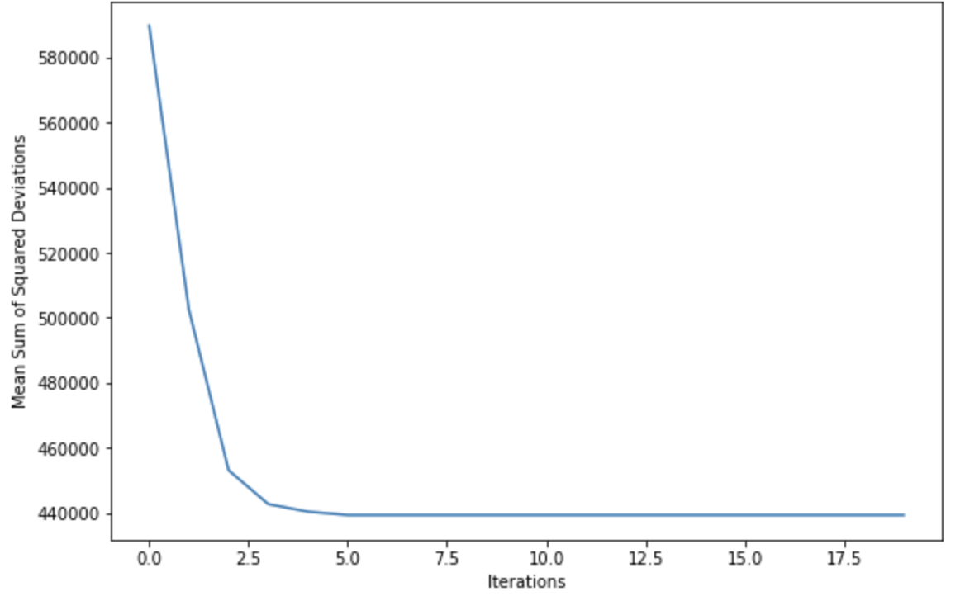
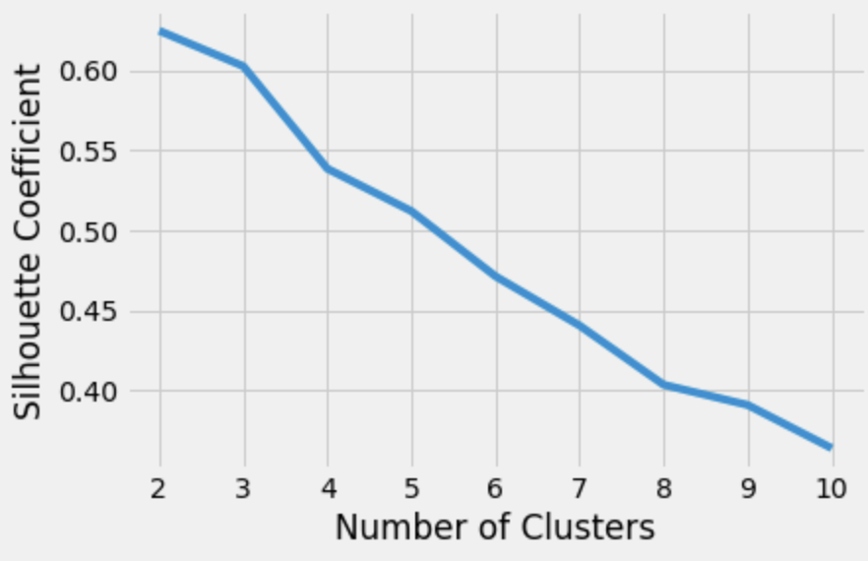
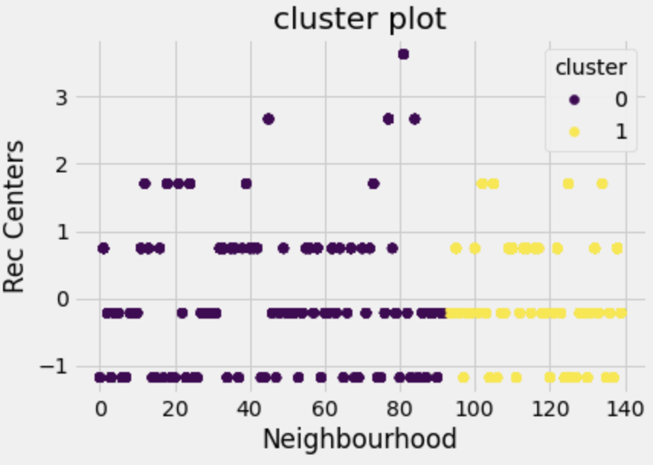
Unsupervised Learning
2 clusters
K =3
Mixed results
Notes:
2 clustering approaches with various results for K means and Hierarchical
K means: 3 to 5 cluster
Hierarchical: 2 clusters
Compared distance between centroids, and each clearly separated
Seemed out of all the attributes, consistently was neighbourhood - there were other ones but not consistent - indicates inconclusive?
Evaluating K:
Elbow - quick and intuition
Silhouette - more precise
Tried smaller dataset - e.g. Theftover, to do for each MCI
So what?
Not used for imputation
Not used for train/test supervised model - supposed to get better scores
Could have used in scenario - call comes in, based on where plots then select appropriate cluster, for which specific supervised model

Slide 12
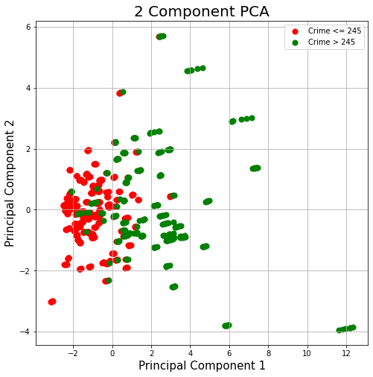
PCA
Features -
Neighbourhood, Crime (MCI), Not_in_workforce
Resident_with_Credentials
Resident_without_credentials
15_to_24_WithCred' (Education)
'25_to_65_WithCred',
Average Household Income
TTL_RES_UNIT' (Total residential Units)
Soc_Units - Social Housing Units (includes Toronto housing)
'RGI', MCI - Crime counts
Target - MCI < = 245 and MCI > 245
Notes:
This slide shows our PCA visualizations separating crime or MCI less than 245 and Crime incidents over 245. Features used are as displayed on the graph

Slide 13
Supervised Learning
Feature Engineering:
Select variables - ['premisetype', 'occurrenceyear', 'occurrencemonth', 'occurrenceday', 'occurrencedayofweek', 'PopDen', 'Resident_with_Credentials', 'Resident_without_credentials', 'Average Household Income', 'TTL_RES_UNIT', 'Soc_Units', 'CRCNumLocations', 'Long', 'Lat', 'PartofDay']
Create new variable - Part of the day
Normalize the numerical variables - Standard scalar (mean- zero, variance- 1)
Encode the categorical variables - One hot encoding (0,1)
Supervised Learning:
Split the data into train and test sets - 70/30 percent.
Predict the category of crime (Assault, Robbery, Theft over, Break enter, Auto theft) using supervised learning algorithms.

Slide 14
Supervised Learning:
5 Classes: 0,1,2,3,4
Method | Test set accuracy
Linear regression | 0.0032
Logistic regression | 0.58
Gradient boosting decision tree | 0.57
K nearest neighbour classifier | 0.63
Support vector classification | 0.54
Decision tree classifier | 0.51
Naïve bayes classifier | 0.39
Random forest classifier | 0.65
Neural network with 3 hidden layers | 0.59
Random forest classifier with under sampling to remove class imbalance
2 Classes: 0,1
Class imbalance
Category | Test set accuracy
Auto theft | 0.79
Break and enter | 0.77
Theft over | 0.76
Robbery | 0.75
Assault | 0.7

Slide 15
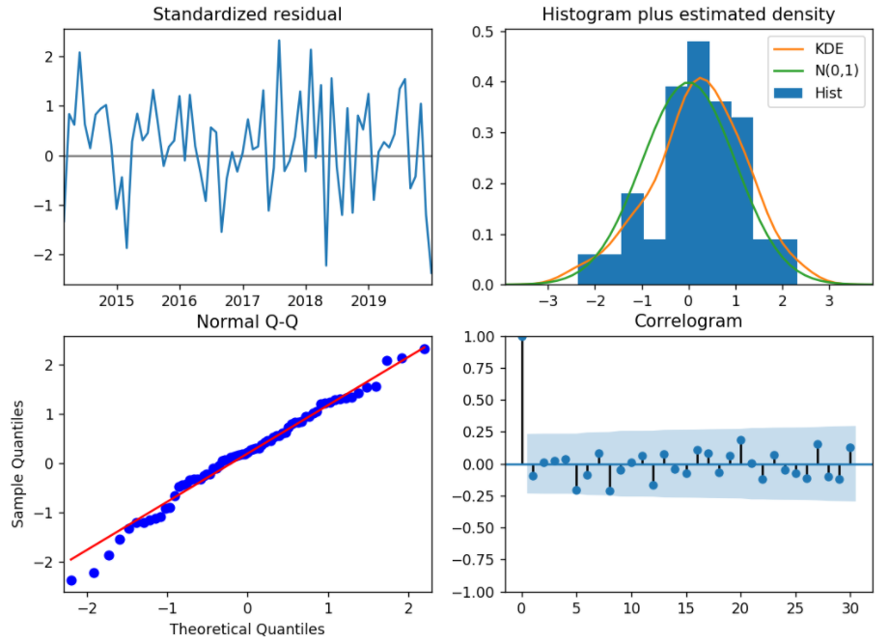
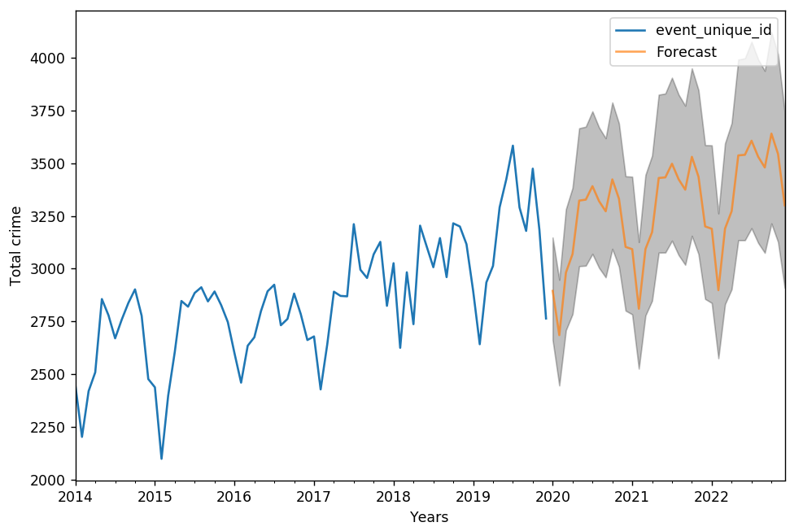
Time Series Analysis:

Slide 16
Conclusion:
Strategies that balance community services, rent geared towards income and social housing across Toronto neighbourhoods will yield better management of existing police resources.
Neighbourhoods with lower rent geared to income units (RGI’s) showed lower tendencies towards crime.
Lower average household income neighbourhoods had higher tendencies towards crime.
Crime most likely to occur was assault.
Supervised learning: Best predictive analysis model on crime categories occurred with random forest classified modelling with a 0.65 accuracy.
Unsupervised learning: Resulted in well distanced clusters, but primarily due to Neighbourhood.
Clusters were not used for improving the supervised models nor for imputing.
Future phase of this project could include - using clusters to help train supervised models, incorporation of real time data through the form of social media and Natural Language Processing e.g. Twitter and/or digitized police scanner.
PCA visualizations with did not yield significant separation of data, when using more than 2 target groups or categories and using 2 dimensional components.
Notes:
Opportunities to balance community resources without necessarily looking at increased policing but through redistribution of police resources and other factors such as community housing, RGI’s, Social Services -- with emphasis on community centres
Findings: -- Read as written

Slide 17
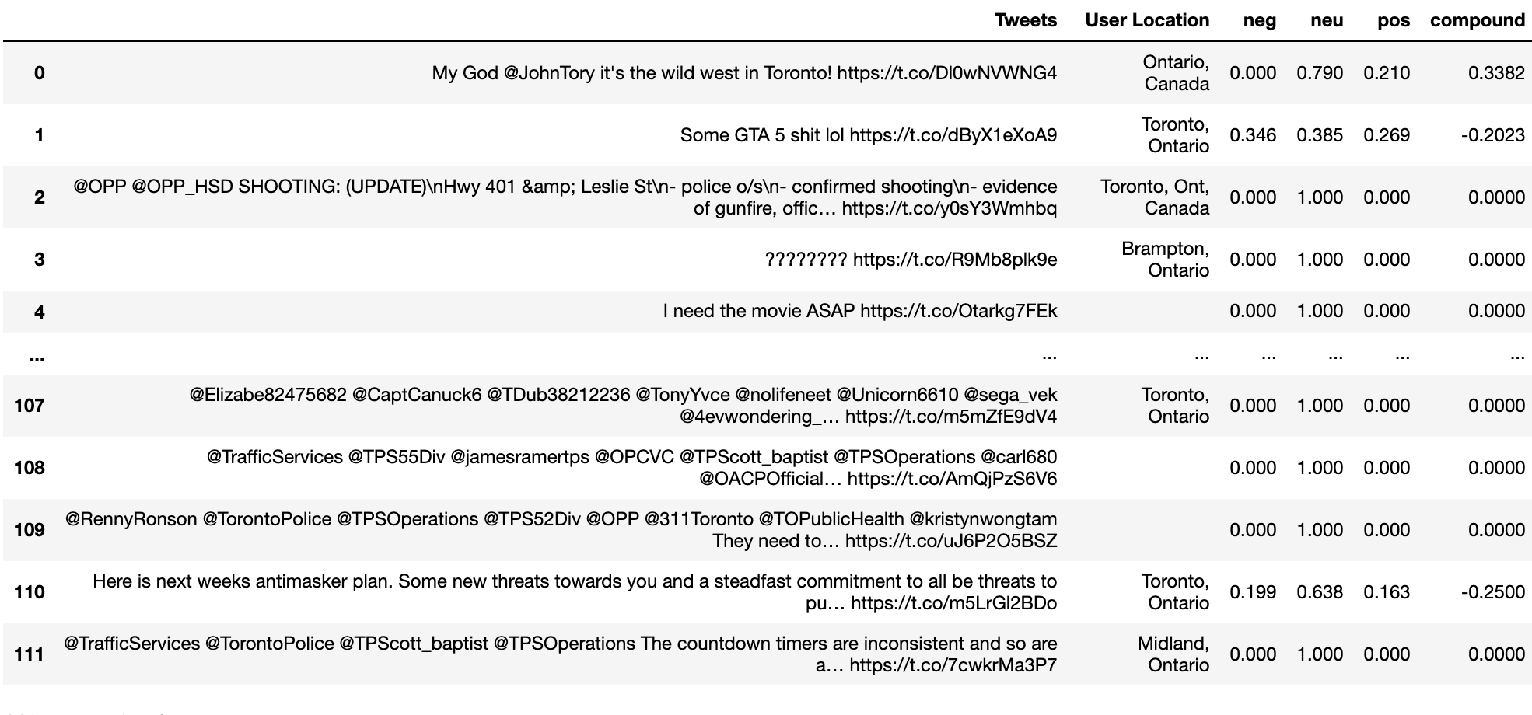
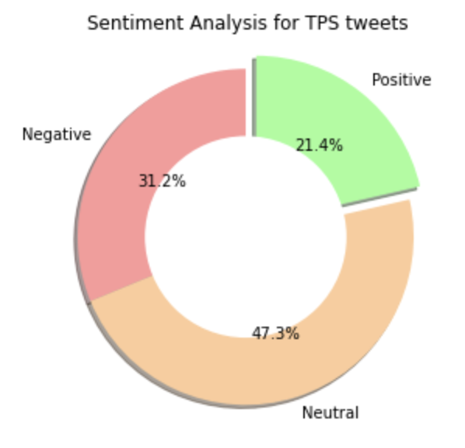

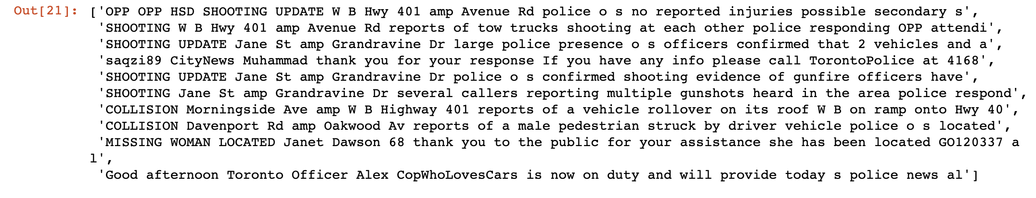
Appendix: Real time updates
Notes:
Unstructured data
Figure out whether to put in findings/conclusion
Twitter feeds from public - not enough citizens reporting like other cities; velocity/volume not required
From TPS Operations - doesn’t require sentiment analysis but more of a dictionary as their tweets are structured
Ideas:
Translated into new crime or as +/- variable for model
Sentiments day over day...may give indication as to the “health” of the citys people
Other consideration is tapping into digitized police scanner - doesnt exist for TPS but does for Fire etc.

